Slide 1
Advancing Equitable Home Upgrades with ENERGY STAR and R2E2
Well-Designed Equitable Home Energy Upgrades: Best Practices and Strategies
Tuesday August 20, 2024 1pm ET

Slide 2
Housekeeping
We are recording this webinar and will be making it available to all registrants within a few business days.
Please keep your microphone on mute during the presentation (you can turn on your video).
To ask a question during the webinar, please submit it via the chat at the bottom of your screen.
Use the chat to engage in respectful and productive discussion with other participants.
Code of conduct: R2E2 will not tolerate behaviors that cause harm or disrupt the learning environment. Please direct message Carolyn Conant if you feel unsafe in this space. Disruptive participants may be removed from the webinar.

Slide 3















Staff and Practitioners
Taylor Jantz-Sell, EPA
ENERGY STAR
Jacelyn Williams, ICF
Annika Brindel, R2E2
ACEEE
Stephanie Sosa-Kalter, R2E2
ACEEE
Ian Becker, R2E2
ACEEE
Carolyn Conant, R2E2
ACEEE
Krista Lee, R2E2
ACEEE
Diana, Morales, ACEEE
Jasmine Mah, ACEEE
Bill Lazar, St. Johns
Housing Partnership
Kristen Simmons,
Mayor’s Office of
Housing, Boston
Jenna Franklin,
City of Seattle, Office of Planning and Community Development
Alon Abramson, Philadelphia Energy Authority
Emily Lucas, Philadelphia Energy Authority
Abigail Corso, Elevate

Slide 4
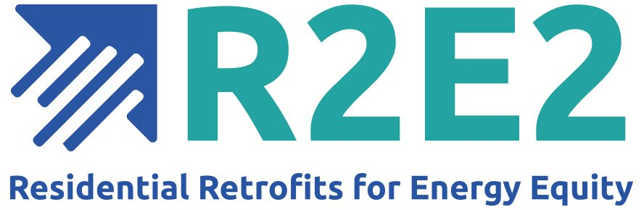
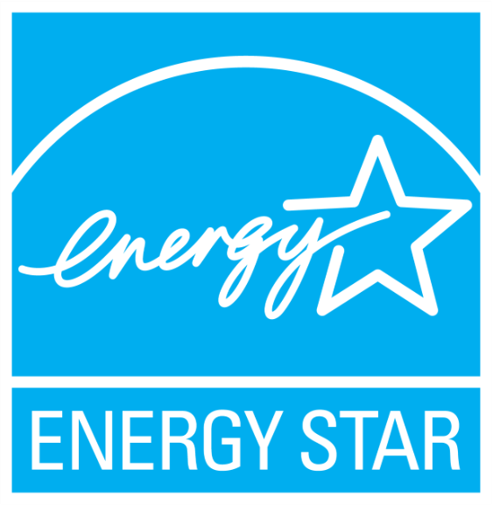
Residential Retrofits for Energy Equity (R2E2) provides deep technical assistance to state, local, and tribal governments as well as community-based organizations to jumpstart energy upgrades for single family and multifamily affordable housing, especially in frontline communities. These retrofits will lower utility bills, reduce greenhouse gas emissions, improve residents’ health, create good-paying local jobs, and help mitigate racial inequity.​
R2E2 is a partnership of the American Council for Energy-Efficient Economy (ACEEE), Elevate, Emerald Cities Collaborative, and HR&A Advisors.
ENERGY STAR® is the government-backed symbol for energy efficiency. The blue ENERGY STAR label provides simple, credible, and unbiased information that consumers and businesses rely on to make well-informed decisions.​

Slide 5
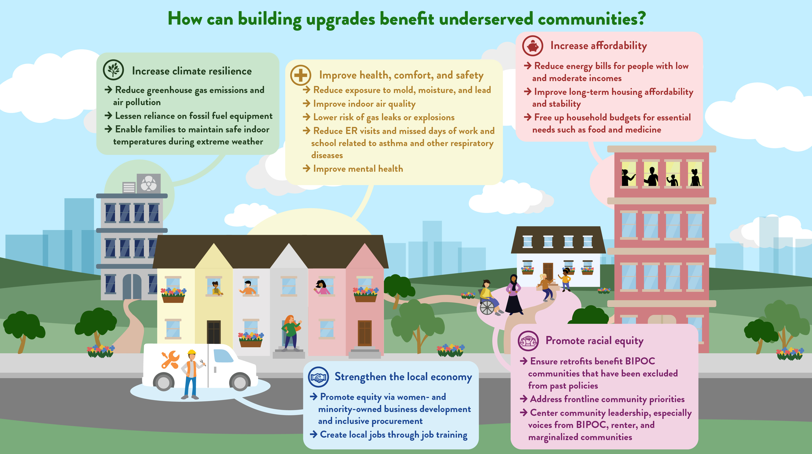

Resource Center for Equitable Home Upgrade Implementation | ENERGY STAR

Slide 6
How to get involved with R2E2
Sign up here to receive periodic updates and information about Residential Retrofits for Energy Equity.
Would you like to be considered for help from R2E2 to plan, launch, implement, or scale your energy upgrade program for low-income housing? If so, please complete our 10-minute survey. As R2E2 secures funding for this work, we will consider and engage those who complete the survey. Our goal is to provide small grants to participating communities in addition to technical assistance. We particularly encourage those who have completed some level of planning for their upgrade program to complete the survey. Please note that this technical assistance pertains to programs, not individual buildings.

Slide 7
About ENERGY STAR
ENERGY STAR is administered by the U.S. Environmental Protection Agency. Thousands of organizations—including nearly 40% of the Fortune 500®—partner with ENERGY STAR. Together with EPA, they deliver cost-saving energy efficiency solutions that protect the climate, improve air quality, and protect public health.
Since 1992, ENERGY STAR and its partners have helped American families and businesses:
Save 5 trillion kilowatt-hours of electricity.
Avoid more than $500 billion in energy costs.
Achieve 4 billion metric tons of greenhouse gas reductions, improve air quality, and protect public health.

Slide 8
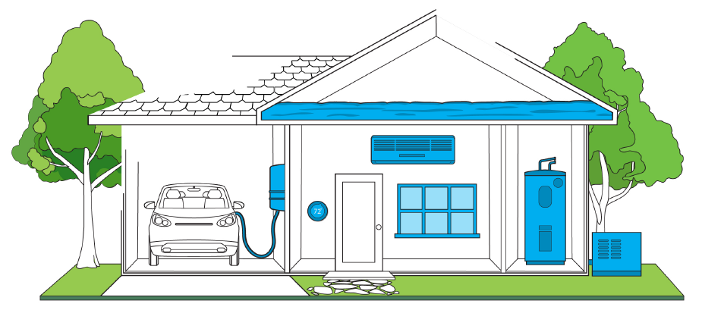
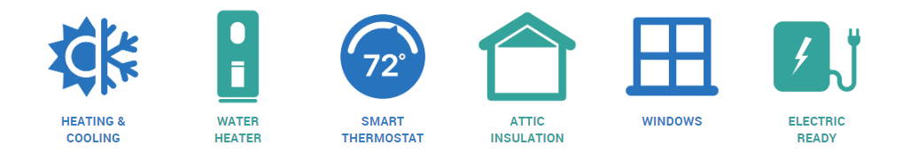
ENERGY STAR Home Upgrade
What is the ENERGY STAR Home Upgrade?
The ENERGY STAR Home Upgrade is a set of six generally applicable, electric energy efficiency improvements that are designed to work together to deliver significant energy and cost savings.
Upgrades can be made all at once or as equipment is replaced
Special emphasis on advancing heat pump technology
ENERGY STAR certified products as applicable
On average, Americans could save approximately $500 a year on utility bills if installing all measures in the ENERGY STAR Home Upgrade
Source: What is the ENERGY STAR Home Upgrade?

Slide 9
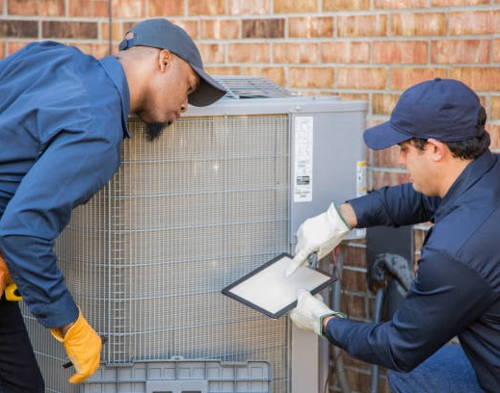
ENERGY STAR Home Upgrade Service Provider Partnership
The ENERGY STAR Program is partnering with companies and community-based organizations that function as a concierge for energy efficiency home upgrade services to bring the benefits of energy savings and a clean energy future to American households nationwide.
Together, we will accelerate the adoption of the elements of an ENERGY STAR Home Upgrade, which present an opportunity for almost every home in America to lower energy bills while improving home comfort and health.
Notes:
Through this partnership, the U.S. Environmental Protection Agency (EPA) provides a national platform for encouraging Americans to take action on energy efficiency in their home. It actively supports service provider efforts to harness best practices for braiding together financial resources to make home upgrades more accessible to low-income households. EPA facilitates information exchange and connects those service providers implementing and promoting home upgrades through webinars, 1-1 conversations, and stakeholder engagements at events, such as the annual ENERGY STAR Partner Meeting. EPA leverages the network of existing ENERGY STAR partners – manufacturers, retailers, utilities, and states – to help form new connections through the service provider partnership that advances productive collaboration. This collaboration with ENERGY STAR and its partners, whether in marketing, communications, program design, or other areas, makes it easier for homeowners to understand and act on making their homes more energy efficient. For more information, read the ENERGY STAR Home Upgrade Service Provider Partnership factsheet (PDF, 383 KB). View marketing materials available to partners.
The ENERGY STAR Home Upgrade is a marketing platform that is also available to ENERGY STAR manufacturers, retailers, and efficiency program sponsor partners. Join in one of those categories. Current partners should speak with their ENERGY STAR contact about how to participate in the ENERGY STAR Home Upgrade Service Provider Partnership.
Companies operating on their own behalf or community-based organizations that provide home upgrade (energy efficiency) concierge services for single-family or multi-family residences, offering some or all the measures in an ENERGY STAR Home Upgrade, and promote those measures in the context of the value of an ENERGY STAR Home Upgrade. Eligible companies/organizations include those that assess and identify homes for relevant upgrades and facilitate or perform the installations of ENERGY STAR certified equipment. However, traditional HVAC contractors, water heater or window installers, and insulation contractors are not eligible.

Slide 10




About the partnership
Through this partnership, the Environmental Protection Agency (EPA)
Provides a national platform for encouraging Americans to take action on energy efficiency in their home
Supports braiding financial resources best practices designed to make home upgrades more accessible to low-income households
Facilitates information exchange and connects partners that are implementing and promoting home upgrades through:
  Webinars
  1-1 conversations
  Stakeholder engagements at events, such as the annual ENERGY STAR Partner Meeting
Leverages the network of existing ENERGY STAR partners to advance productive collaboration
Assists in educating Americans on how to make their homes more energy efficient (e.g. marketing, communications, program design, or other areas)
For additional information on the partnership, click here . To view marketing materials available to partners, click here.
Notes:
The ENERGY STAR program is partnering with companies and community-based organizations that simplify efficient electrification home upgrades
Leverage the brand and platform to help communicate how everyone can be a part of the clean energy future
Access to an expansive network of partners advancing efficient electrification

Slide 11
Advancing Equitable Home Upgrades with ENERGY STAR and R2E2 – Resource Center
The EPA is committed to supporting community-based organizations, small businesses, and local governments in equitable, efficient electrification home upgrade deployments.
Working with R2E2 to Build & Share Resources through this 2024 Workshop Series
  Visit www.energystar.gov/equitableupgrades

Slide 12
Workshop series schedule
May 21: Navigating Organizational Funding for Home Energy Upgrade Programs in Justice 40 Communities
  Target Audience: Community-based organizations (CBOs), non-governmental organizations (NGOs), Non-profit Organizations, small businesses, local governments, state governments, Tribes
August 20: Well-Designed Equitable Home Energy Upgrades: Best Practices and Strategies
  Target Audience: Community-based organizations (CBOs), non-governmental organizations (NGOs), Non-profit Organizations, small businesses, local governments, state governments, Tribes
September 10: Centering Affordability in Low-Income Home Electrification Programs
  Target Audience: Community-based organizations (CBOs), non-governmental organizations (NGOs), Non-profit Organizations, small businesses, local governments, state governments, Tribes
October 8: Incorporating Health and Safety into Home Energy Upgrade Programs
  Target Audience: Community-based organizations (CBOs), non-governmental organizations (NGOs), Non-profit Organizations, small businesses, local governments, state governments, Tribes
November 19: Maximizing Incentives for Low to No-Cost Home Energy Upgrades: Stacking and Braiding
  Target Audience: Program implementers, contractors, etc.
Notes:
Topics include addressing health and safety roadblocks, leveraging the ENERGY STAR Home Upgrade marketing platform and Service Provider Partnership, stacking and braiding with the Inflation Reduction Act funds e.g. home electrification appliance rebates, and energy affordability considerations for electrification.

Slide 13



Presenters
Ian Becker
Manager of R2E2 at ACEEE
Ian serves on the Residential Retrofits for Energy Equity (R2E2) team, where he conducts research, manages projects, and provides technical assistance to local governments and private sector stakeholders related to improving the energy efficiency of affordable housing.
Diana Morales
Senior Research Analyst at ACEEE
Diana leads research on equitable energy efficiency policies and programs. She also provides technical assistance to local governments and community-based organizations seeking to advance energy efficiency in their cities.
Jasmine Mah
Senior Research Analyst at ACEEE
Jasmine studies policies, programs, and funding sources that simultaneously improve human health and energy efficiency. She also cooperates with researchers across different programs, including the utilities, buildings, state policy, and local policy teams.

Slide 14
Audience Poll

Slide 15
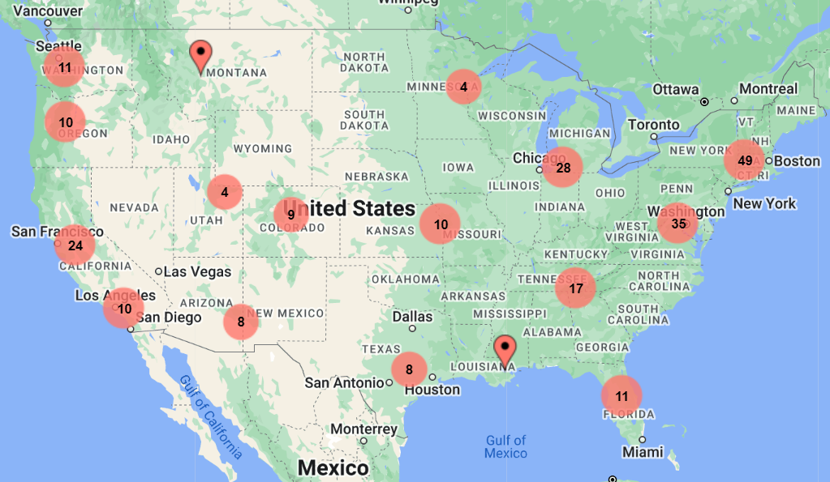
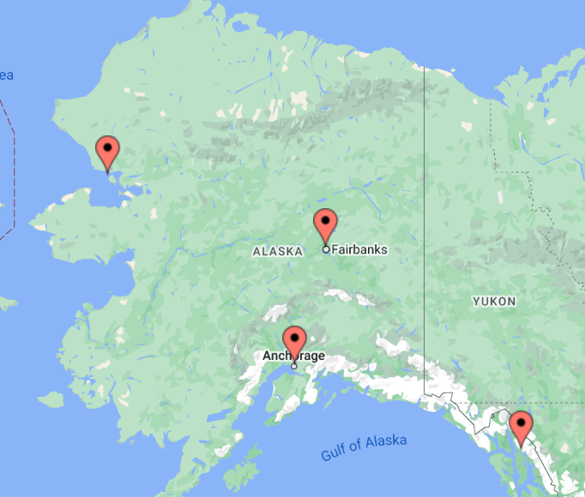
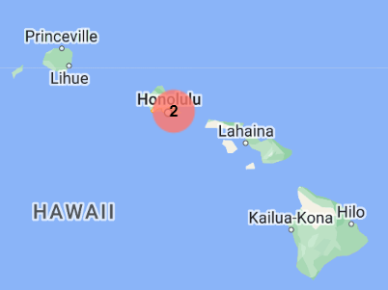
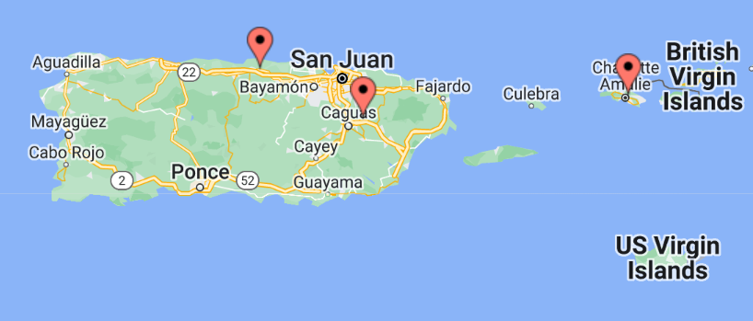
Workshop Attendees

Slide 16
Learning Goals
Identify Best Practices
Overview of the R2E2 Playbook
Discuss Case Studies

Slide 17
Workshop Agenda
1:25-2:55pm ET - Presentation and Q&A
  R2E2 Playbook Overview
  Best Practices and Case Studies
  Audience Polls
  Q&A
2:55 –3:10pm ET- 15-minute Break
3:10pm-3:40pm ET - Interactive Discussion of Best Practices with Field Experts
3:40pm-3:55pm ET- Wrap Up Audience Polls and Links to Resources

Slide 18
The R2E2 Playbook r2e2playbook.org

Slide 19
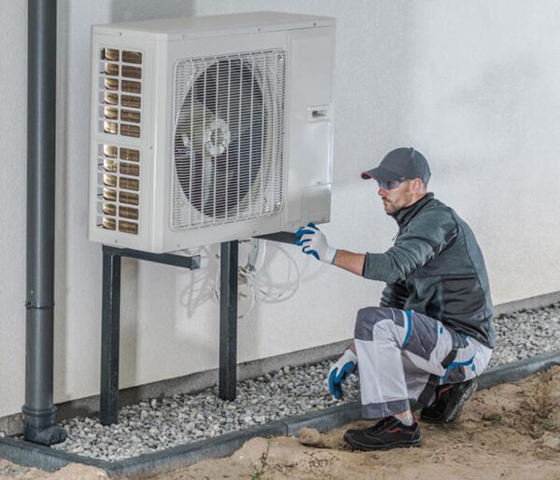
The Problem
Many low- and moderate-income households have not reaped the benefits of past energy efficiency efforts.
  67% percent of households with low incomes face a high energy burden.
  Energy burdens are disproportionate: Black, Hispanic, Native American, older adult households, and families residing in low-income multifamily housing experience higher energy burdens.

Slide 20
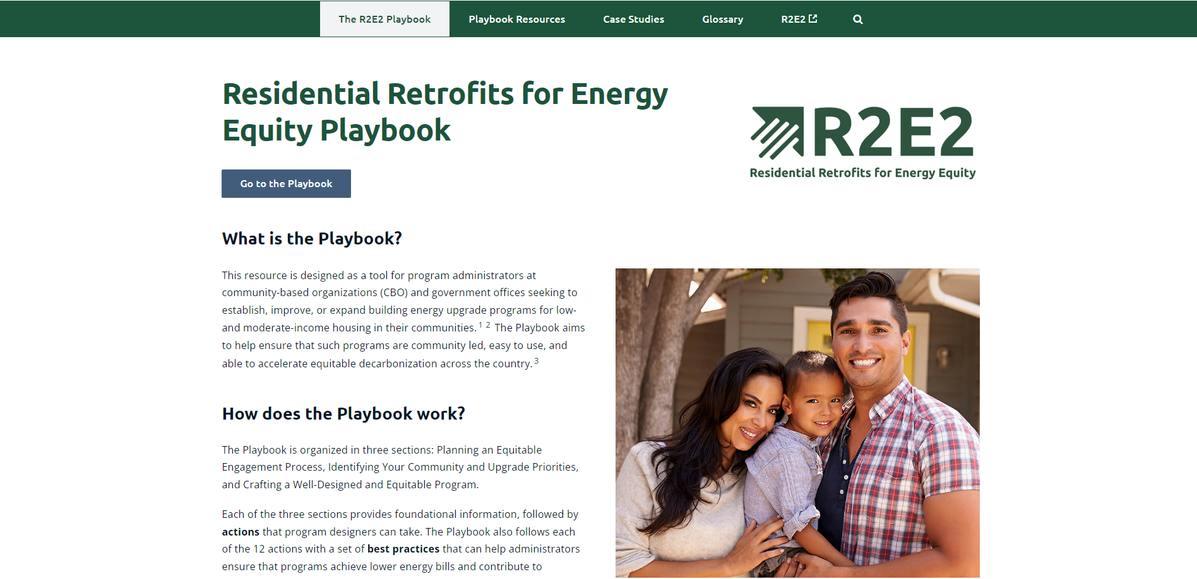
HVAC Installation in SW Virginia. Source – Appalachian Voices

Slide 21












12 Recommended Actions
1. Begin with a landscape analysis. | 7. Design program in coordination with partners.
2. Design equitable engagement activities. | 8. Prioritize the most energy insecure LMI households to receive upgrades.
3. Identify program focus areas. | 9. Build accountability into the program.
4. Establish program upgrade offerings. | 10. Ensure the program provides health and safety measures.
5. Design program offerings to prevent increased household costs and displacement. | 11. Ensure the program streamlines how users access funding.
6. Create an easy-to-use program intake, participation, and support process. | 12. Ensure the program helps build out a local green workforce.

Slide 22
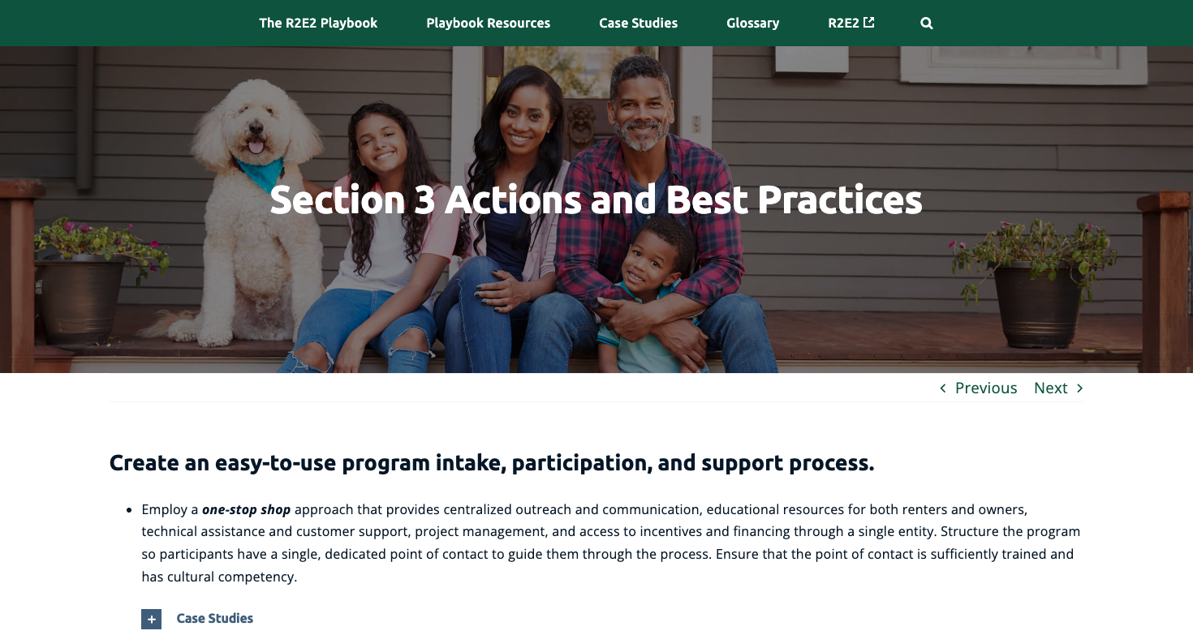
HVAC Installation in SW Virginia. Source – Appalachian Voices

Slide 23
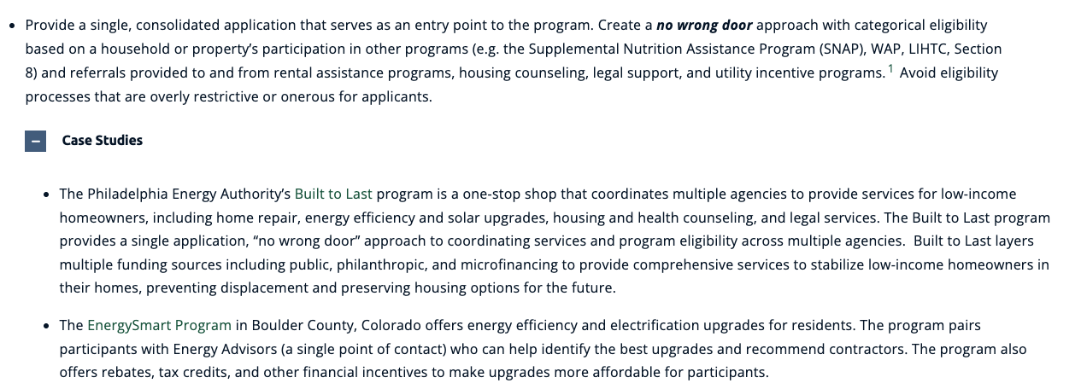
Case Study Examples

Slide 24
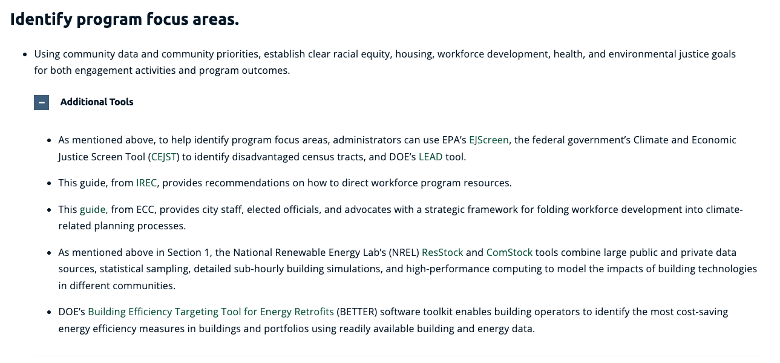
Additional Tool and Resource Examples

Slide 25



Playbook Stats
40+ Best Practices
90+ Case Studies
120+ Additional Tools and Resources

Slide 26

Presenter
Diana Morales
Senior Research Analyst at ACEEE
Diana leads research on equitable energy efficiency policies and programs. She also provides technical assistance to local governments and community-based organizations seeking to advance energy efficiency in their cities.

Slide 27

1 Begin with a landscape analysis
Examples:
  ACTION: Analysis should cover relevant existing policies, programs, and stakeholders; the existing building stock in your locality; the relationship between communities and local governing entities; the current energy efficiency workforce; and the capacity limits of potential partners.
  CASE STUDY: Greenlink Analytics' data visualization tool.
  TOOLS: Ecosystem Mapping, and the Equitable Home Electrification Toolkit from RMI and Emerald Cities Collaborative.
Graphic from Greenlink Analytics website.
Notes:
Greenlink Analytics, a nonprofit focused on energy data analytics, developed a data visualization tool (GEM) to explore the potential relationship between historical redlining and current energy-related issues facing residents of Atlanta.
Ecosystem mapping identifies potential anchor partner organizations with the expertise, track record, and capacity to provide support with assessing equity impacts, setting equity goals, and designing a process to codevelop comprehensive decarbonization policies. This content was developed for the Equitable Home Electrification Toolkit provided by the Rocky Mountain Institute (RMI) and Emerald Cities Collaborative and is intended for use by local governments and community groups tasked with developing a roadmap for electrifying their community’s housing stock.

Slide 28


2 Design equitable engagement strategies
Examples:
  ACTION: Center marginalized and underrepresented groups in all engagement and ensure that their perspectives are reflected in the leadership and decision-making structure of the planning process.
  CASE STUDIES: Minneapolis's Green Zones. Task forces that address issues like public health, climate resilience, and environmental justice. Seattle's Equitable Development Initiative, co-created with community advocates, is an equity grant-making program investing in community-envisioned and -led solutions that address physical and cultural displacement pressures faced by communities of color and marginalized populations most at risk.
  TOOLS: Emerald Cities Collaborative and PODER's climate resilience planning tool.
Photo by Sharon Chang, City of Seattle website
Notes:
Minneapolis designated two Green Zones, or areas where residents have experienced disproportionate pollution impacts and systemic marginalization. Each Green Zone has a task force consisting of individuals who live or work in the affected neighborhoods. The task forces are responsible for implementing work plans that address issues like public health, climate resilience, and environmental justice.
The Climate Equity & Community Engagement in Building Electrification Toolkit developed by Emerald Cities Collaborative and PODER derived from the City of San Francisco’s engagement with Urban Sustainability Directors Network’s Zero Cities Project. The purpose of this initiative was to experiment with different forms of community engagement to highlight best practices, lessons learned and models for creating effective community engagement around equity and climate resiliency through anchor-community strategies.

Slide 29
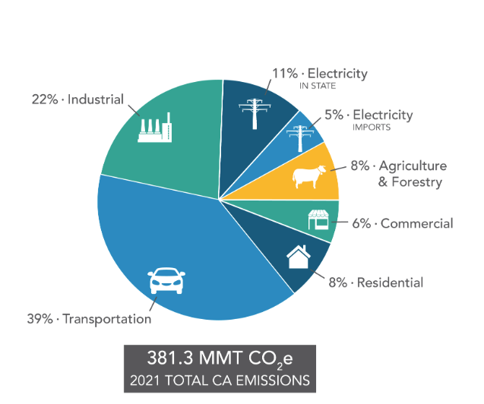
3 Identify program focus areas
Examples:
  ACTION: Alongside other program goals, make greenhouse gas emission reductions a metric for program success.
  CASE STUDY: Los Angeles Department of Water and Power's incentives for energy efficiency measures.
  TOOLS: EPA's GHG emission inventories at the local and state level.
California's GHG Emission Inventory, from State of California.
Notes:
At the building level, the Los Angeles Department of Water and Power (LADWP) provides incentives for energy efficiency measures if whole building energy savings are above 10%. Through the Comprehensive Affordable Multifamily Retrofits Program, LADWP offers different incentives based on the size of property, the location of efficiency upgrades, and the metric tons of carbon dioxide equivalent (MTCO2e) reduced. For multifamily buildings with fewer than 65 units, LADWP provides $5,400 per MTCO2e reduced in common areas and $6,750 per MTCO2e in renter units. Larger multifamily buildings earn up to $6,200 and $7,750 per MTCO2e, respectively.
EPA provides numerous tools that can help develop GHG emissions inventories at the state and local level.

Slide 30

4 Establish program upgrade offerings
Examples:
  ACTION: Prioritize comprehensive efficiency upgrades and electrification in program offerings.
  CASE STUDY: Massachusetts' Low-Income Energy Affordability Network (LEAN) Deep Energy Retrofit Pathway.
  TOOLS: ACEEE paper - "Analysis of Electric and Gas Decarbonization Options for Homes and Apartments," by Steven Nadel and Lyla Fadali.
Image from LEAN's website.
Notes:
Massachusetts’ Low-Income Energy Affordability Network (LEAN) Deep Energy Retrofit Pathway provides an incentive for buildings that meet a 40% energy use reduction compared to existing conditions. These projects include higher-than-standard weatherization and may include electrification of space heating and water heating.
This paper from ACEEE reports the results of a home-by-home analysis of several thousand homes across the United States, looking at gas vs. electric decarbonization and deep retrofits options for space and water heating and their lifecycle costs. The graph on the right presents various decarbonization options that are covered in the paper.

Slide 31
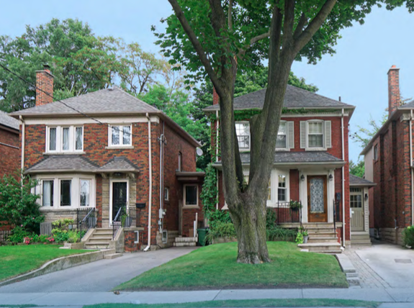

5 Design program offerings to prevent increased household costs and displacement
Examples:
  ACTION: Protect housing affordability for unsubsidized rental properties that are not subject to pre-existing affordability commitments.
  CASE STUDIES:
    Affordability restrictions required by the Efficiency Navigator in Middleton and Madison, Wisconsin. Elevate is the Energy Navigator for this program.
    Affordability restrictions required by Seattle's Multifamily Weatherization Program.
  TOOLS: ACEEE paper - "Building Decarbonization Solutions for the Affordable Housing Sector," by Dan York, Charlotte Cohn, Diana Morales, and Carolin Tolentino.
Notes:
The Efficiency Navigator in Middleton and Madison, WI, a partnership run jointly by Sustain Dane and Elevate, requires owners of unsubsidized housing to sign a contract stipulating that the units using the program are occupied by households at or below 80% AMI, and requires the owner to use reasonable efforts to maintain the unit as housing for LMI households for a period of three years after the completion of the upgrade work.
In Seattle, the Multifamily Weatherization Program provides project management services at no cost, but to be eligible, building owners must commit to keeping rents affordable for at least three years and at least half of tenants must meet income qualifications.
This report from ACEEE describes the benefits, barriers, and strategies for decarbonizing buildings in the affordable housing sector. It identifies and describes selected decarbonization and deep retrofit programs serving affordable housing markets.

Slide 32
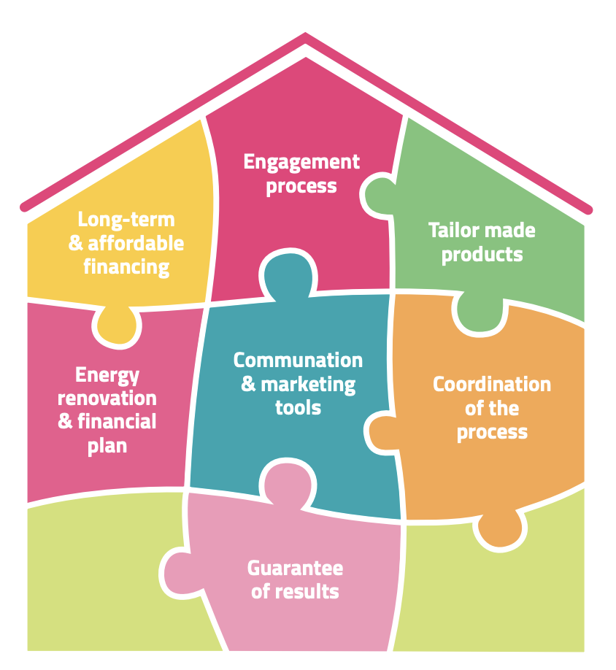
6 Create an easy-to-use program intake, participation, and support process
Examples:
  ACTION: Employ a one-stop shop approach.
  CASE STUDY: Massachusetts' LEAN Program.
  TOOLS: ACEEE's Multifamily Energy Savings Project, and Innovate's step-by-step process for setting up a one-stop shop.
Graphic from Innovate's report.
Notes:
Employ a one-stop shop approach that provides centralized outreach and communication, educational resources for both renters and owners, technical assistance and customer support, project management, and access to incentives and financing through a single entity. Structure the program so participants have a single, dedicated point of contact to guide them through the process. Ensure that the point of contact is sufficiently trained and has cultural competency.
The Massachusetts Low-Income Energy Affordability Network (LEAN) multifamily program is notable as an integrated and well-coordinated one-stop shop program to serve owners and operators of low-income and affordable housing. The LEAN network includes CAAs, utilities, state agencies, and nonprofits. The program requires for-profit affordable housing owners to abide by an affordability period based on the level of incentives received. LEAN has served more than 220,000 residential dwelling units and delivered more than $100 million in energy savings since its inception.
For additional materials specifically covering outreach and engagement for multifamily buildings, please see ACEEE’s Multifamily Energy Savings Project, which has numerous resources that specifically cover low-income and affordable multifamily programs.
This guide from Innovate provides a step-by-step process for setting up a one-stop shop. While this organization is based in the United Kingdom, the information in the resource is still applicable for program administrators in the United States.

Slide 33
Presenter
Jasmine Mah
Senior Research Analyst at ACEEE
Jasmine studies policies, programs, and funding sources that simultaneously improve human health and energy efficiency. She also cooperates with researchers across different programs, including the utilities, buildings, state policy, and local policy teams.

Slide 34
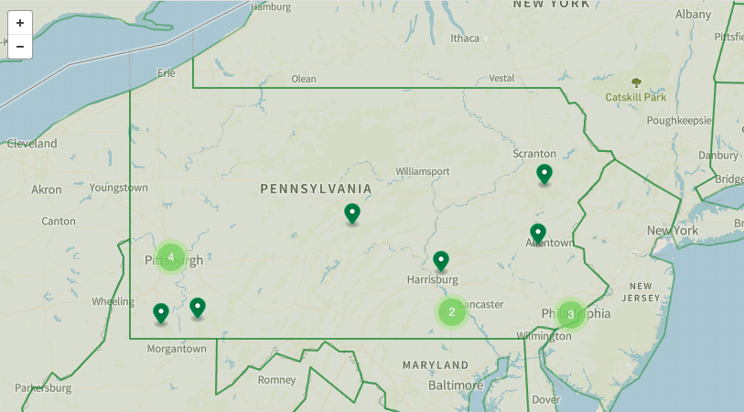
7 Design program in coordination with partners
Examples:
  ACTION: Establish robust partnerships so program offerings are well coordinated.
  CASE STUDY: Minneapolis' 4d Program.
  TOOLS: DOE's Better Buildings Residential Network website, which provides strategies developed to maintain strong strategic partnerships with trusted local companies and organizations, and DOE's partnership toolkit.
Map from BBRN Network Website.
Notes:
This strategy builds on the earlier recommendation to establish multiple program offerings. Possible program partners can be utilities, nonprofits, and state or local government agencies. Partnering with community-based organizations (CBOs) is incredibly important, as CBOs can directly connect you to community members who can help shape program development to reflect community needs.
Minneapolis collaborated across the city’s economic development and sustainability agencies on the 4d Program, a program to preserve housing and provide energy incentives. This program is administered jointly by the health and housing departments.
The Better Buildings Residential Network website from DOE provides strategies developed to maintain strong strategic partnerships with trusted local companies and organizations as part of the Healthy Homes Incentive Program’s goal to complete 100 home energy upgrade projects. There are additional useful case studies available in DOE’s partnership toolkit.

Slide 35
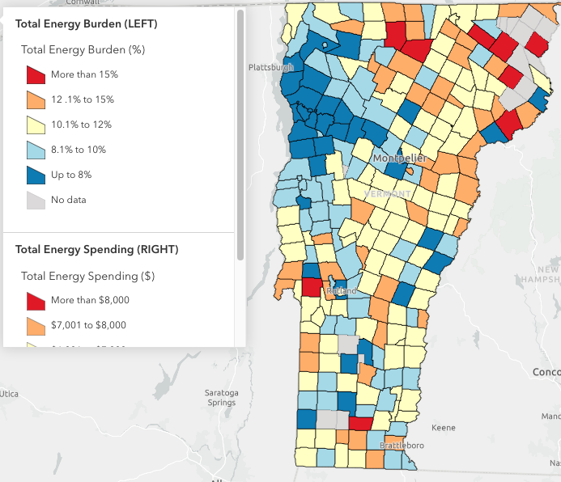
8 Prioritize the most energy insecure and disadvantaged households to receive upgrades
Examples:
  ACTION: Target offerings to LMI households and ensure that multiple ownership structures and types of affordable housing (including both subsidized and unsubsidized) are eligible for program offerings.
  CASE STUDY: Efficiency Vermont's Targeted High Use program.
  TOOLS: ACEEE Report - "Toward More Equitable Energy Efficiency Programs for Underserved Households," by Jennifer Amann, Carolin Tolentino, and Dan York.
Energy Burden Map from Efficiency Vermont.
Notes:
Previous research has shown that residential energy efficiency programs primarily reach white, higher-income homeowners. As a result, communities of color, low-income residents, and renters tend to get left behind by business-as-usual programs. This is why it's essential to create programs that specifically cater to the needs of underserved residents, especially LMI households.
Efficiency Vermont, a statewide regulated energy efficiency utility, offers various programs, incentives, and rebates to encourage its customers to retrofit homes and buildings. The organization’s Targeted High Use (THU) program incentivizes direct install of efficiency and electrification measures such as appliances, heat pumps, and heat pump water heaters to qualifying houses with high electricity use. This program is promoted to customers who are deemed likely to be income eligible, use 5,000 kWh per year or more, and have an energy burden greater than 6%.
This ACEEE report focuses on policy approaches that yield equitable energy efficiency programs. It advises on how to effectively engage and serve residential customer populations that untargeted programs do not serve well.

Slide 36
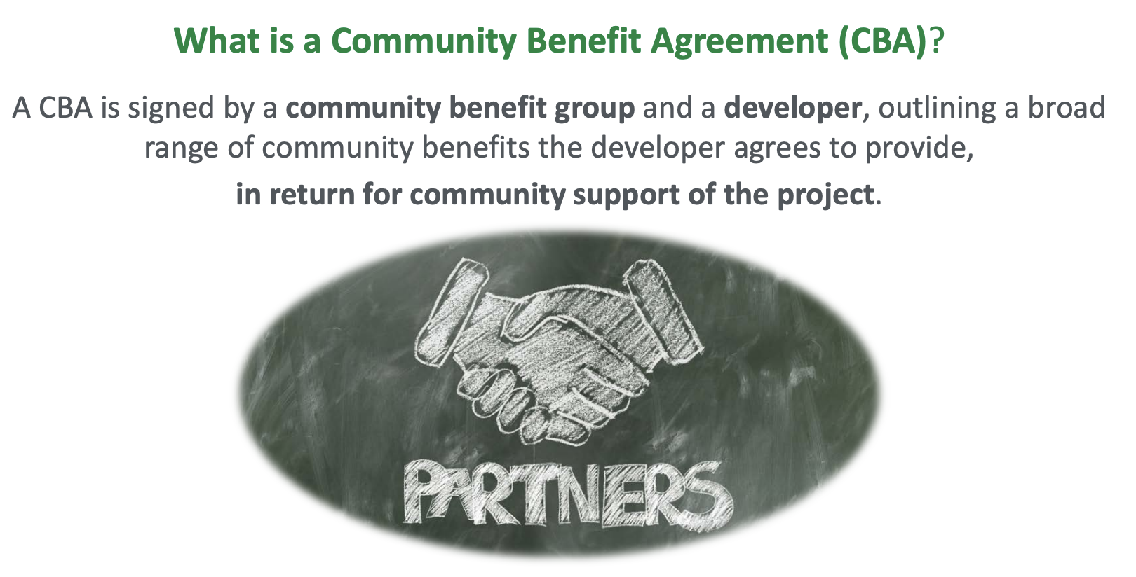
9 Build accountability into the program
Examples:
  ACTION: Establish community and/or workforce benefits agreements between the program and community members.
  CASE STUDY: Somerville's Community Benefits Agreement.
  TOOLS: DOE's CBA Toolkit, which includes a comprehensive guide, FAQs, and presentation slides to educate stakeholders on the value and process of CBAs.
Graphic from DOE's CBA Resource Guide Presentation.
Notes:
It is incredibly important to build trust with the communities you intend to serve with your program. Community benefits agreements clearly outline the benefits that community members receive from a project, while workforce benefits agreements typically describe workforce practices to improve economic development in the local community (e.g., hiring local workers, sourcing from minority businesses).
Somerville, MA’s Union Square Community Benefits Agreement pledges to prioritize local hiring for construction jobs, bolstering the economy and providing practical training opportunities through a local career and technical education program at the regional high school. Additionally, it offers relocation benefits to existing businesses, opportunities for new spaces in redevelopment, and a robust funding commitment to affordable housing, underlining a commitment to sustainable and inclusive growth.
DOE’s CBA Toolkit includes a comprehensive guide, FAQs, and presentation slides to educate stakeholders on the value and process of CBAs. These agreements are strategic partnerships that provide communities with direct benefits like local hiring and economic contributions in return for supporting development projects, fostering mutual gains for developers, governments, and communities. This approach aligns the interests of all parties, ensuring that government officials and developers support community needs while also achieving their own objectives.

Slide 37
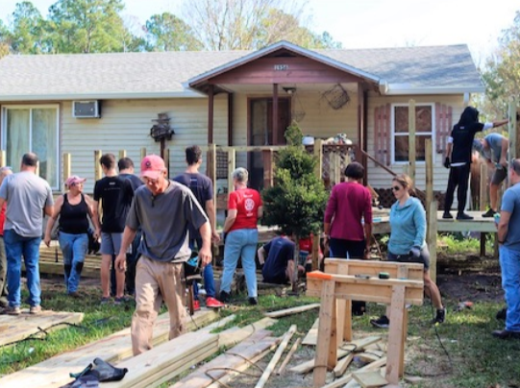

10 Ensure the program provides health and safety measures
Examples:
  ACTION: Incorporate upgrade offerings, such as mold and asbestos remediation, that improve resident health, safety, and comfort. Ensure program provides or engages existing pre-weatherization offerings to lower barriers to participation.
  CASE STUDY: St. John's Housing Partnership.
  TOOLS: CDC's comprehensive guide to understanding multiple aspects of a health home.
Photo from St. John's Housing Partnership website.
Notes:
Many homes that can benefit most from retrofits cannot receive upgrades due to significant health and safety hazards. Remedying these hazards through intentional funding and program offerings can help more households receive retrofits and their accompanying benefits.
In Florida, the St. John’s Housing Partnership offers repair services for single-family homeowners. By covering the upfront costs and easing the burden of underlying repairs, the partnership increases participation in its energy efficiency program (including comprehensive upgrades and direct installation). Bill Lazar from St. John's Partnership will soon speak more about the program.
This manual from the CDC is a comprehensive guide to understanding multiple aspects of a healthy home. It also discusses the history of affordable housing in the United States.

Slide 38
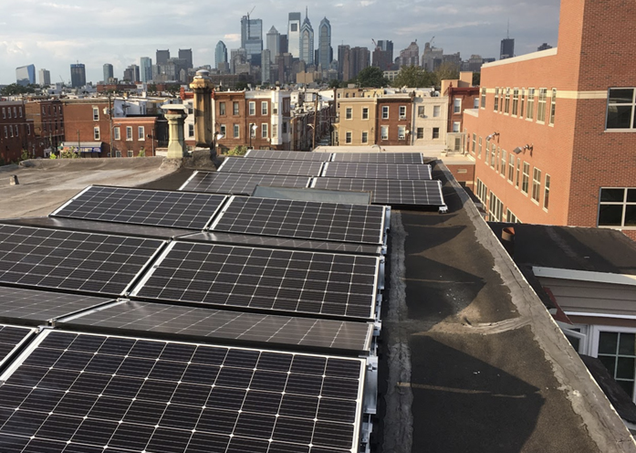



11 Ensure the program streamlines how users access funding
Examples:
  ACTION: To fill funding gaps, leverage and layer a variety of funding sources in addition to the primary program funding source. ACTION: If possible, cover the full cost of replacing appliances.
  CASE STUDIES: Built to Last program in Philadelphia, PA for funding gaps. Boston's Healthy and Green Retrofit Pilot Program for appliance replacement.
  TOOLS: Built to Last in-depth case study, from C40 cities. Includes guidelines for creating community-driven building retrofit programs.
Photo from City of Philadelphia's website.
Notes:
It is very beneficial for a program to offer generous financial incentives that cover all or most of the upfront costs for customers. Braiding or combining multiple funding sources can ensure that your program has enough funds for upgrades.
In Philadelphia, the Built to Last program uses a partnership between the Philadelphia Energy Authority (PEA) and Philadelphia Green Capital Corp (PGCC) to help identify and close funding gaps through layering and streamlining existing fundings sources and services. Alon Abramson and Emily Lucas from Philadelphia Energy Authority will soon speak more about the program.
Boston’s Healthy and Green Retrofit pilot program creates a custom green retrofit plan for participants’ buildings, which includes replacing appliances. To do this work, building owners may receive up to $50,000 per unit, assistance accessing energy efficiency financial incentives, construction management services including bidding and hiring a general contractor, and construction oversight and inspections throughout the process. Kristen Simmons from the Boston's Mayor's Office of Housing will soon speak more about the program.
For more information on this program, please see this case study, part of guidelines for creating community-driven building retrofit programs assembled by the Building Electrification Institute (BEI), Elevate, and C40 Cities Climate Leadership Group.

Slide 39
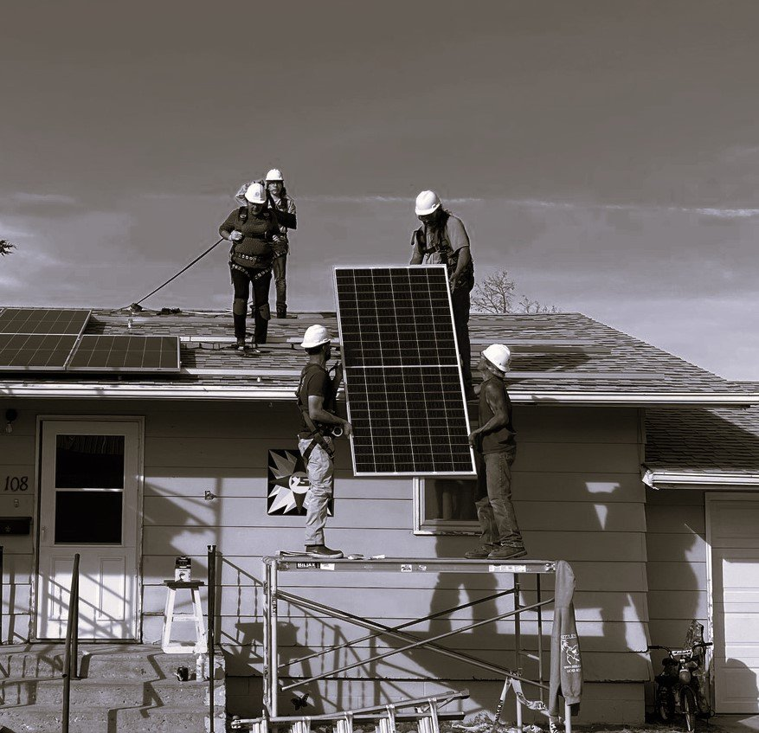
12 Ensure the program helps build out a local green workforce
Examples:
  ACTION: Through program offerings and partnerships, identify barriers to building a diverse workforce and deploy strategies to hire local underrepresented groups into good-paying local jobs. Track the creation of these jobs.
  CASE STUDY: Red Cloud Renewables, operating in the Pine Ridge Reservation.
  TOOLS: ACORE's Accelerate Membership Program, which supports women and minority-led renewable energy companies.
Image from Red Cloud Renewables website.
Notes:
Scaling retrofit programs will require scaling a diverse clean energy workforce. It is particularly important for workforce development to train and upskill workers in the local community, where retrofits will be taking place.
Red Cloud Renewables is an Oglala Lakota-led organization on the Pine Ridge Reservation that provides free, place-based workforce development opportunities for Native Americans. It is a pre-apprenticeship readiness program that includes training on how to perform energy assessments and complete retrofit projects, while focusing on home safety and occupant health measures. It has successfully worked with more than 70 tribes since 2002 and has created more than 600 jobs in weatherization, solar installation, and sustainable home building.
The American Council on Renewable Energy’s (ACORE) Accelerate Membership Program is a cohort-based program that supports women and minority-led renewable energy companies by connecting them to resources, including complimentary access to events, exclusive briefings, tools, and advocacy.

Slide 40
Q&A and
Hear from the Practitioners

Slide 41






Meet the Practitioners
Bill Lazar
Executive Director
St. Johns Partnership
Alon Abramson
Vice President, Residential Programs
Philadelphia Energy Authority
Kristen Simmons
Program Lead for Residential Decarbonization
Boston’s Mayor’s Office of Housing
Emily Lucas
Director, Residential Programs
Philadelphia Energy Authority
Jenna Franklin
Division Director, Equitable Development Initiative
City of Seattle, Office of Planning and Community Development
Abigail Corso
Chief Strategy Officer
Elevate

Slide 42
15 Minute Break
Up Next: Interactive Discussion of Best Practices with Field Experts

Slide 43
Break-Out Activity
Room 1
Room 2
Room 1
Bill Lazar, St. Johns Housing Partnership (FL)
Room 2
Kristen Simmons, Boston Mayor’s Office of Housing
Room 3
Jenna Franklin, Seattle Office of Planning and Community Development
Room 4
Emily Lucas, Philadelphia Energy Authority
Room 5
Abby Corso, Elevate (implementer for Energy Navigator in WI)

Slide 44
Agenda for Breakout Rooms
Introductions: name, pronouns, organization, location
Icebreaker Question: Why did you attend this workshop today or tell us what is challenging about implementing best practices in your community?
What relationships (existing or new) might support you in implementing this best practice?
Is there something that you’d like to dig deeper on from today’s workshop?
What are you struggling with? How can you pull from best practices to tackle challenges?

Slide 45
Breakout Room Debrief Polls

Slide 46
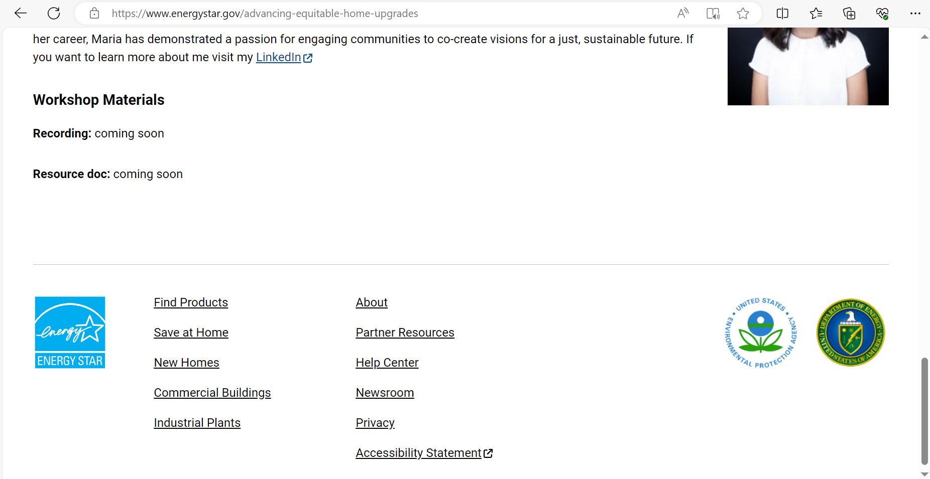
Next Steps and Resources
You can find recording and workshop materials at:
https://www.energystar.gov/partner_resources/products_partner_resources/eshuspp/equitable-upgrades/workshop-2-best-practices-and-strategies

Slide 47
Workshop series schedule
May 21: Navigating Organizational Funding for Home Energy Upgrade Programs in Justice 40 Communities
  Target Audience: Community-based organizations (CBOs), non-governmental organizations (NGOs), Non-profit Organizations, small businesses, local governments, state governments, Tribes
August 20: Well-Designed Equitable Home Energy Upgrades: Best Practices and Strategies
  Target Audience: Community-based organizations (CBOs), non-governmental organizations (NGOs), Non-profit Organizations, small businesses, local governments, state governments, Tribes
September 10: Centering Affordability in Low-Income Home Electrification Programs
  Target Audience: Community-based organizations (CBOs), non-governmental organizations (NGOs), Non-profit Organizations, small businesses, local governments, state governments, Tribes
October 8: Incorporating Health and Safety into Home Energy Upgrade Programs
  Target Audience: Community-based organizations (CBOs), non-governmental organizations (NGOs), Non-profit Organizations, small businesses, local governments, state governments, Tribes
November 19: Maximizing Incentives for Low to No-Cost Home Energy Upgrades: Stacking and Braiding
  Target Audience: Program implementers, contractors, etc.
Notes:
Topics include addressing health and safety roadblocks, leveraging the ENERGY STAR Home Upgrade marketing platform and Service Provider Partnership, stacking and braiding with the Inflation Reduction Act funds e.g. home electrification appliance rebates, and energy affordability considerations for electrification.

